Slide 1
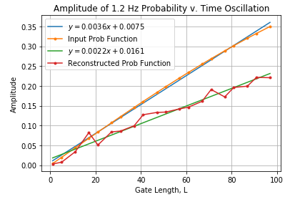
Previous method:
Take the maximum frequency in the vicinity of 1.2 Hz
Make the power for all other frequencies zero
Inverse FT the modified power spectrum
**This tends to underestimate the amplitude of the probability(time) function
New method:
Take two frequency bins: the one just below 1.2 Hz, and the one just above 1.2 Hz
Sum those two powers
For whichever frequency is closer to 1.2 Hz, associate the summed power with that frequency.
Make the power for all other frequencies zero.
Inverse FT the modified power spectrum.

